Slide 1

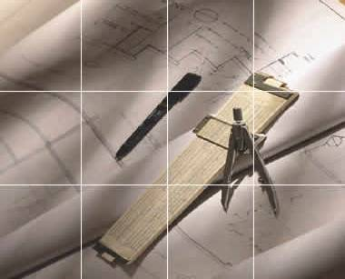

Chapter 4
Orthographic
Writing

Slide 2
TOPICS
Views selection
Alignment of views
Orthographic writing steps
Basic dimensioning
Tangency and intersections

Slide 3
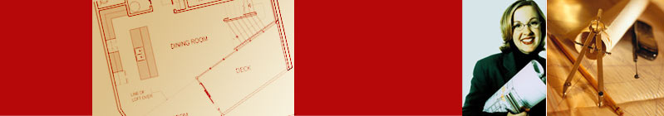

View Selection

Slide 4
VIEW SELECTION STEPS
1. Orient the object to the best position
relative to a glass box.
2. Select the front view.
3. Select adjacent views.

Slide 5
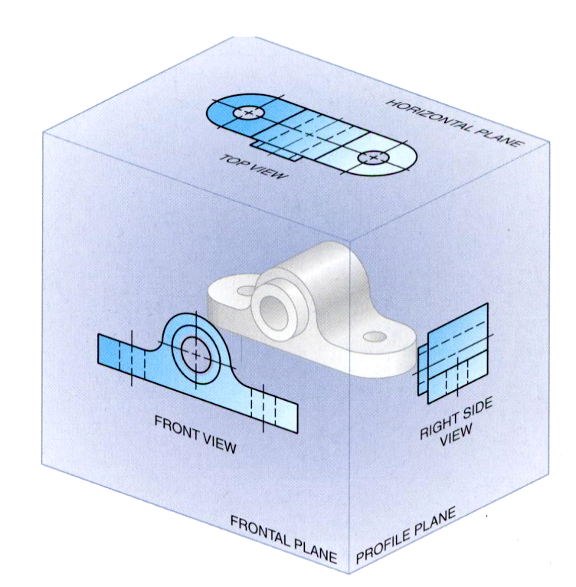
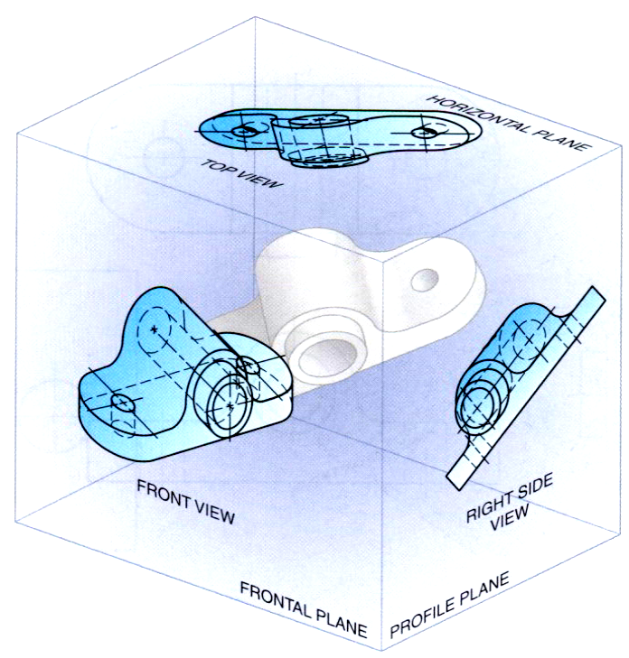
STEP 1 : Orient the Object
The object should be placed in its natural position.
The object should presents its features in actual
size and shape in orthographic views.
GOOD
NO !

Slide 6
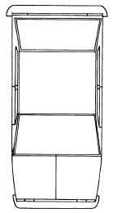
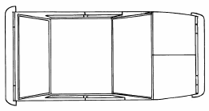
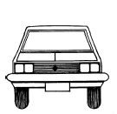
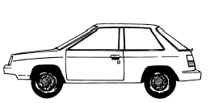
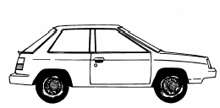
STEP 2 : Select a Front View
The object’s longest dimension should be presented as a width.
First choice
Second choice
Waste more space
Inappropriate
GOOD

Slide 7
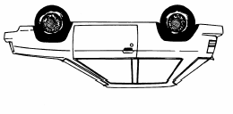
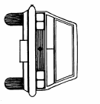
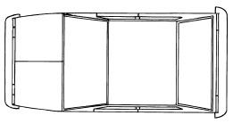
STEP 2 : Select a Front View
The adjacent views that are projected from the selected front view should appear in its natural position.
Inappropriate

Slide 8


STEP 2 : Select a Front View
Choose the view that have the fewest number of
hidden lines.
GOOD
Inappropriate

Slide 9

STEP 3 : Select an Adjacent View
Choose the view that have the fewest number of
hidden lines.
GOOD
Inappropriate
GOOD
Inappropriate

Slide 10
STEP 3 : Select an Adjacent View
Choose the minimum number of views that can
represent the major features of the object.
Necessary
Hole’s location can be specified on the same view.
Easy to understand
Difficult to interprete.
Necessary

Slide 11
STEP 3 : Select an Adjacent View
Choose the views that are suitable to a drawing
space.
POOR
Not enough space
for dimensioning.

Slide 12
STEP 3 : Select an Adjacent View
Choose the views that are suitable to a drawing
space.
GOOD

Slide 13
Example : View selection
D
mislead to…
H
W
F.V.
W
D
H
F.V. & T.V.
Three views
F.V. & R.S.V.
✓
✓
✓
Size description
✗
✓
✓
Shape description

Slide 14
ONE-VIEW DRAWING
Flat part having a uniform thickness.
1 Thick
Unnecessary
These 2 views provide only information
about the part thickness !

Slide 15
ONE-VIEW DRAWING
Cylindrical-shaped part.
Unnecessary
Repeat !
Infer from CL
Unnecessary

Slide 16
TWO-VIEW DRAWING
There exists an identical view.
Repeat !
Unnecessary

Slide 17
TWO-VIEW DRAWING
The 3rd view has no significant contours of the object.
Unnecessary

Slide 18
TWO-VIEW DRAWING
The 3rd view has no significant contours of the object.
Unnecessary

Slide 19
Alignment of Views

Slide 20

PROJECTION SYSTEMS
1. First angle system
- European country
- ISO standard
First Quadrant
2. Third angle system
- Canada, USA,
Japan, Thailand
Third
Quadrant

Slide 21




ORTHOGRAPHIC PROJECTION
1st angle system
3rd angle system

Slide 22
ORTHOGRAPHIC VIEWS
1st angle system
3rd angle system
Folding
line

Folding
line
Folding
line

Folding
line

Slide 23
ORTHOGRAPHIC VIEWS
1st angle system
3rd angle system
Right Side View
Front View
Top View
Top View
Front View
Right Side View

Slide 24
PROJECTION SYMBOLS
First angle system
Third angle system

Slide 25
PROJECTION SYMBOLS
Suggested proportion
d
1.7d
2.2d

Slide 26
Orthographic Writing Steps

Slide 27
WRITING STEPS
1. Select the necessary views
2. Layout the views.
3. Project the views.
4. Dimension the views.

Slide 28
1. SELECT THE NECESSARY VIEWS
TOP
FRONT

Slide 29


2. LAYOUT THE VIEWS
A4
152
64
25
45
152
Choose an
appropriate scale
1:1

Slide 30
PROJECT THE VIEWS

Slide 31
DIMENSION THE VIEWS
x
x
z
y
y
x
x
y
y
PART NAME
NOTES
1. Dimensions in millimeters.
2. ….

Slide 32
TRANSFERING
THE DEPTH DIMENSION
1. Direct measurement
3
2
27
1
0
2
3
27
0
1
Starting point

Slide 33
TRANSFERING
THE DEPTH DIMENSION
2. Use miter line
45°
Views too close

Slide 34
Basic Dimensioning

Slide 35
COMPONENTS
1. Extension lines
10
27
10 Drill, 2 Holes
R16
2. Dimension lines
3. Leader lines
4. Dimension numbers
17
5. Local notes
43

Slide 36
Tangencies and Intersections

Slide 37
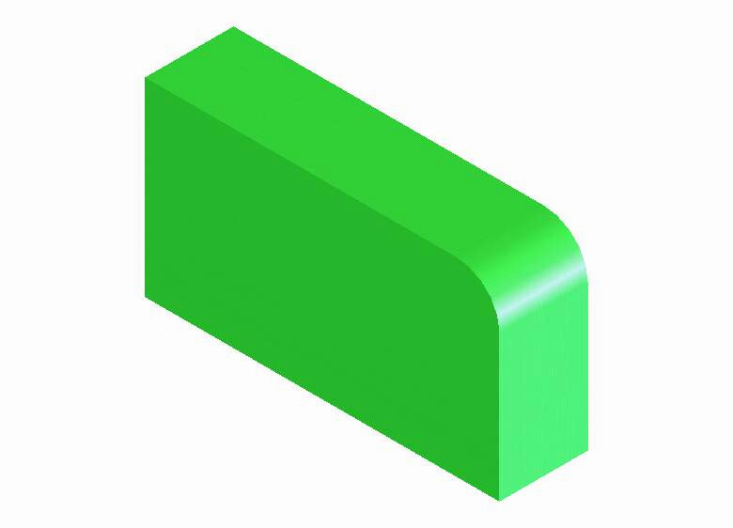
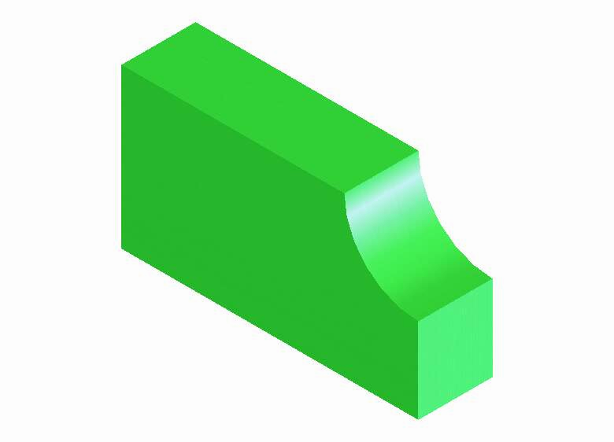
TANGENT & INTERSECTION
No line is formed when curved surface tangent
to a plane surface.
Line is formed when curved surface intersects
a plane surface.
No line
tangent
intersect
No line
tangent
intersect

Slide 38
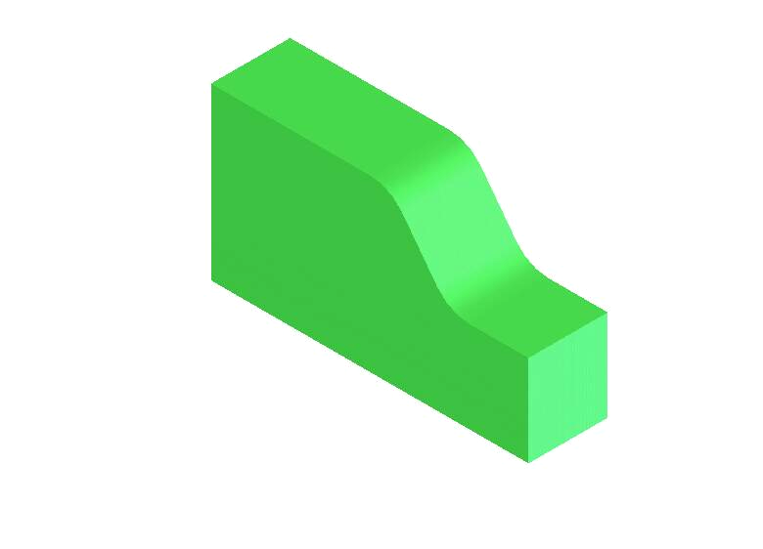

TANGENT & INTERSECTION
limiting element
tangent
tangent
tangent
intersect
plane

Slide 39
TANGENT & INTERSECTION
tangent
No line
tangent
intersect
tangent
tangent
No line
No line
tangent
tangent

Slide 40
QUIZ

Slide 41
1. Which should be the natural position of the light
bulb ? (20 sec)
a
b)
c)
d)
0
5
10
15
20

Slide 42
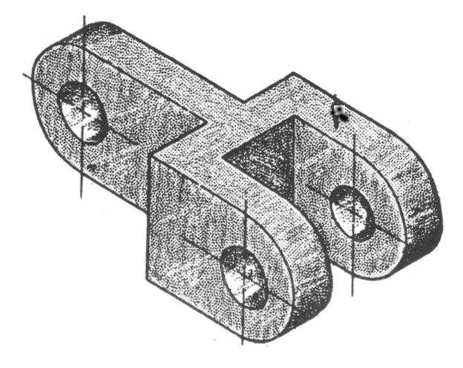
2. Which are the necessary views ? (60 sec)
A-C-E
E-B-D
E-A
E-C
E
D
B
A
C
F
0
15
30
45
60

Slide 43
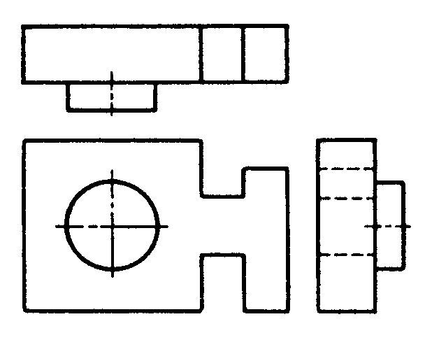
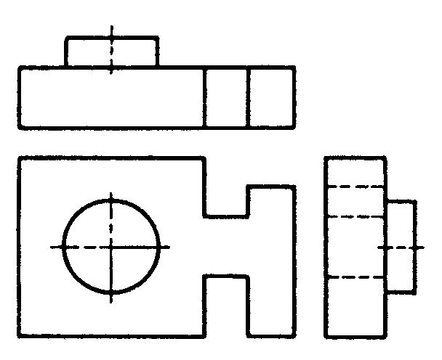
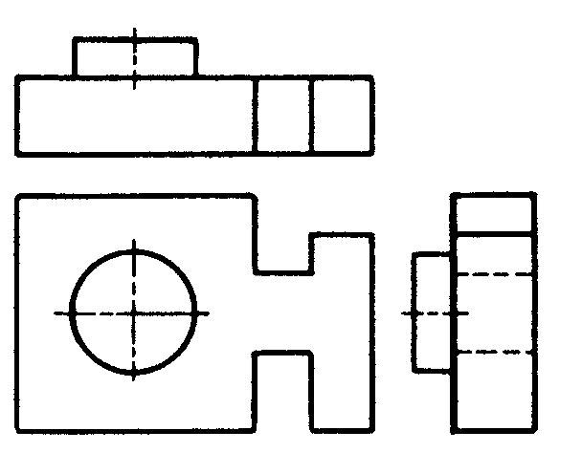
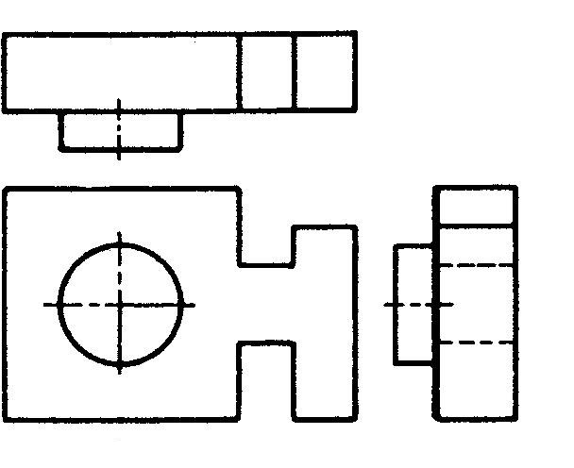
3. Which is in correct first angle projection ? (180 sec)
a)
b)
c)
d)
0
45
90
135
180

Slide 44
4. Which is in correct third angle projection ? (180 sec)
a)
b)
c)
d)
0
45
90
135
180

Slide 45
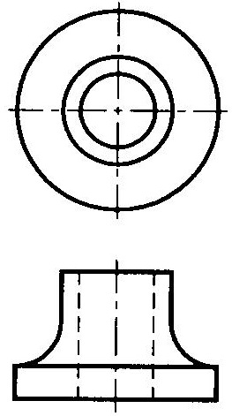
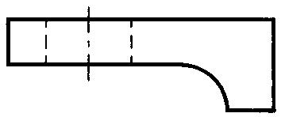
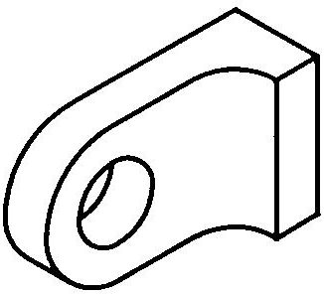
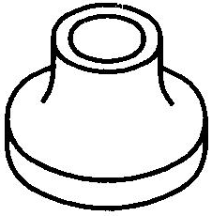
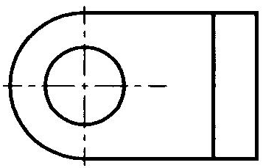
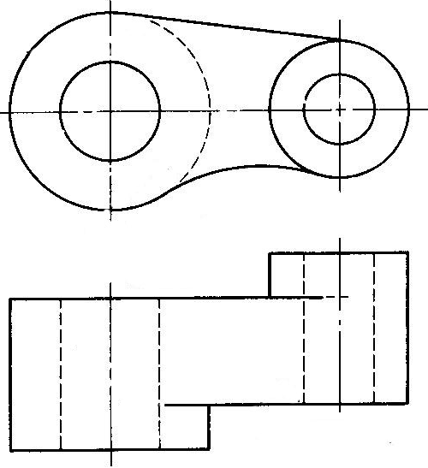
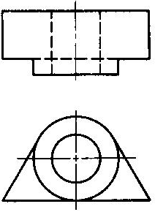
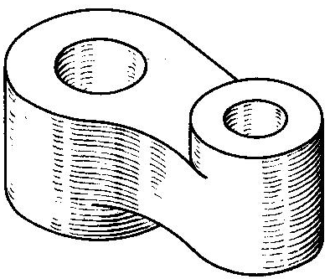
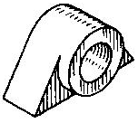
5. Which is a wrong 3rd angle orthographic views ?
(180 sec)
a)
b)
c)
d)
0
45
90
135
180

